Slide 1
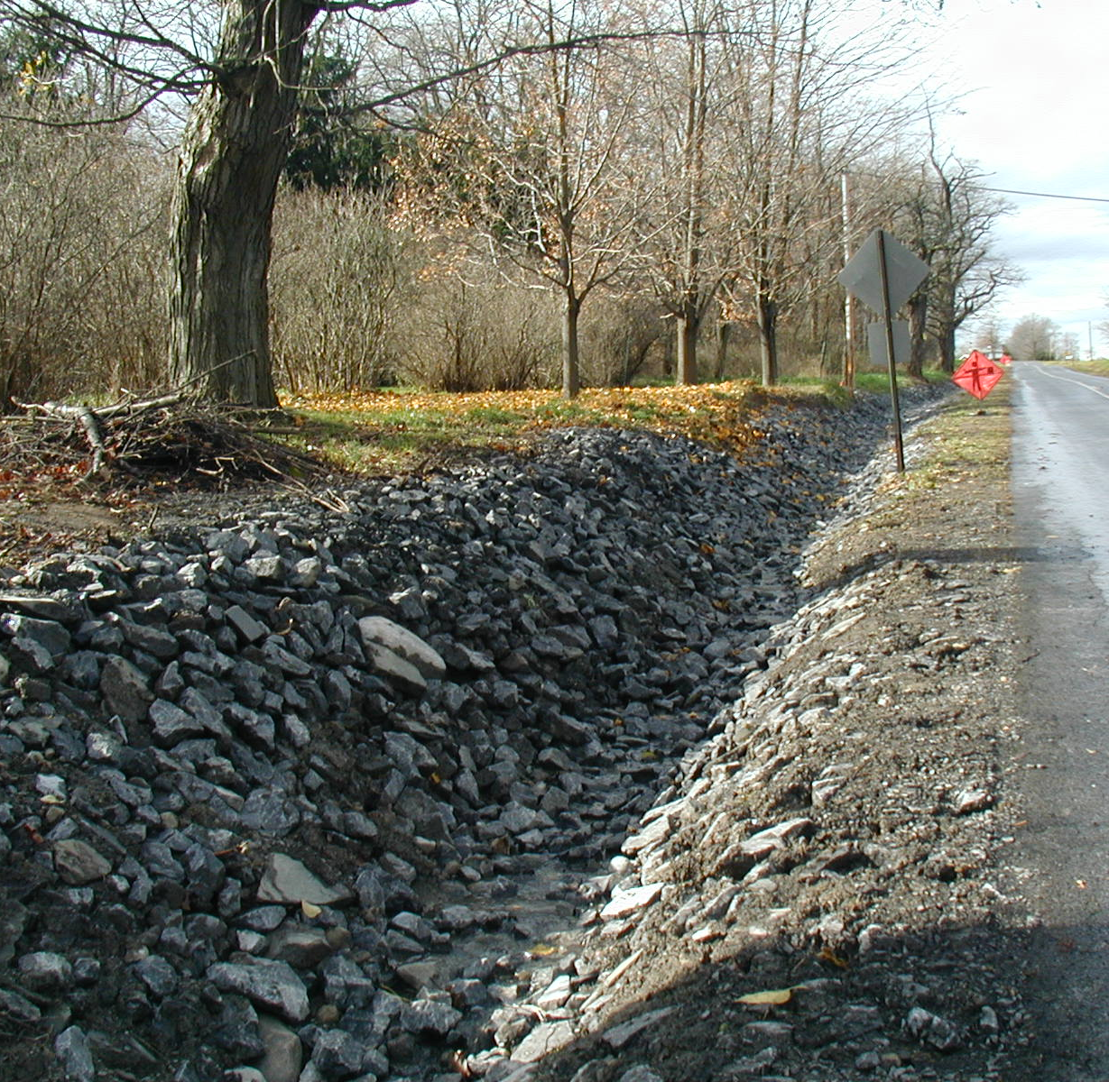


Seneca & Cayuga Road Drainage
Assessment Project: Phase I
Seneca Drainage Results
& Beta Outreach Portal
Ian Smith, SWIO
28 May 2026
Seneca Water Quality Symposium
Notes:
Welcome
Introduce self and panelists
Webinar guidance

Slide 2

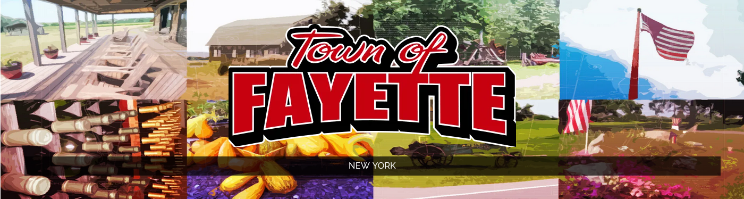
Acknowledgements
This presentation was prepared with funding provided by the New York State Department of State under Title 11 of the Environmental Protection Fund.

Slide 3
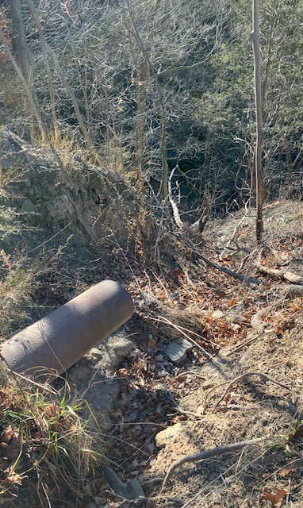
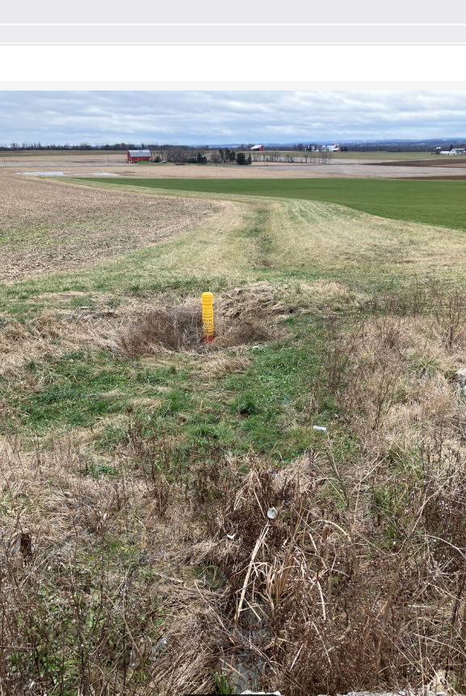
Project Outcomes
  Implementation (Phase II)
    Prioritize 10-20% worst locations for BMP (Best Management Practice) Implementation
  Funding, Design and Permit Efficiency/Accuracy
    Repository of information to support implementation needs
  Secondary Water Quality Improvement Projects
    Sequestration opportunities
    Adjacent/Downstream BMPs
Notes:
At the last presentation we circulated what we called the Action Matrix. Feedback on what actions could be done; gauge opposition and support. Additional input through conversations with districts, and planners.
Currently working refining and filling out the other categories of the matrix and develop on implementation strategy.

Slide 4
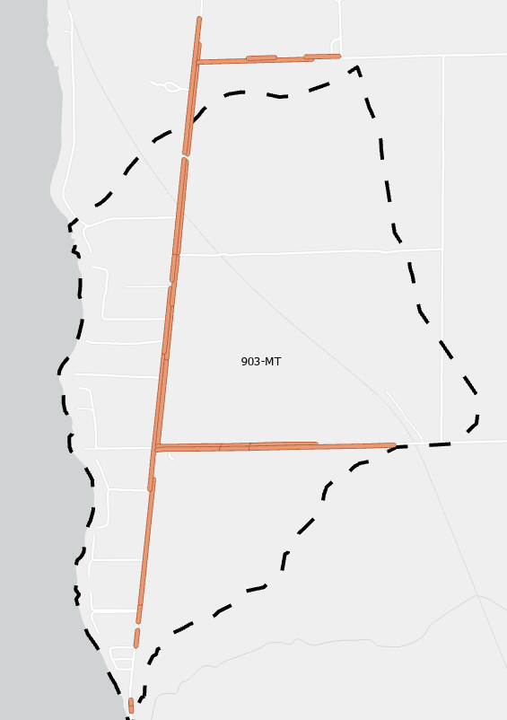
Project Overview
  Goals
    Quantifiable prioritization
    Basin/Network based
    Implementation
    Easy long-term updates
    9E/TMDL tracking
    Outreach
  Deliverables
    Assessment/Prioritization
    BMP Schedule
    Information Portal/Database
  Drainage Basin
    Stormwater Runoff
    Phosphorous Loading
  Ditch
    Velocity Control
    Pollutant Loading
  Culvert
    Condition
    Impact
  Weighting Factor
Notes:
At the last presentation we circulated what we called the Action Matrix. Feedback on what actions could be done; gauge opposition and support. Additional input through conversations with districts, and planners.
Currently working refining and filling out the other categories of the matrix and develop on implementation strategy.

Slide 5
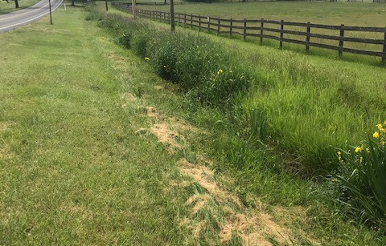
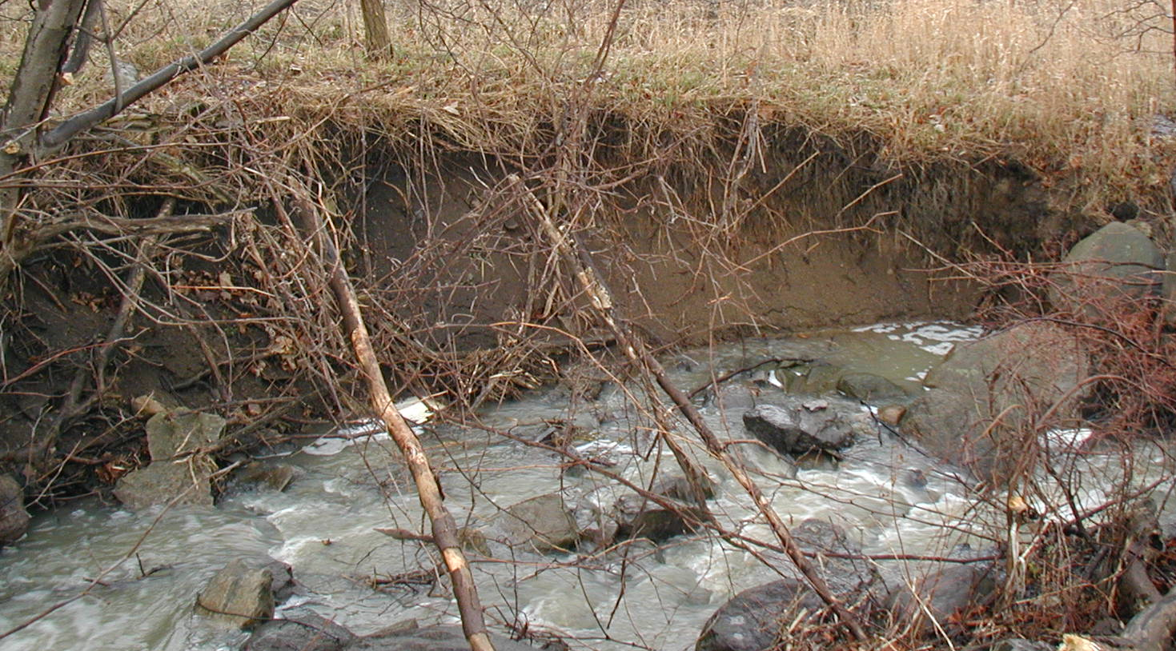
Ditch Data & Quantification
  Pollutant Load (2x)
    Universal Soil Loss Equation
    Parameters
      Length (RTK)
      Depth (Direct Measurement)
      Soil Weight (County-wide)
      Lateral Recession Rate (Observational)
  Velocity Control
    Manning’s Equation: V = 1/n x R^{2/3} x s^{1/2}
    Roughness (n) controllable factor
    Parameters
      Slope (RTK Calculation)
      Roughness (Observational & Necessitated by Slope)
  Metadata
    Drainage Basin
    Municipality
    Jurisdiction/Management
    Field Notes (e.g. cleaned, catch basin, etc.)
Notes:
At the last presentation we circulated what we called the Action Matrix. Feedback on what actions could be done; gauge opposition and support. Additional input through conversations with districts, and planners.
Currently working refining and filling out the other categories of the matrix and develop on implementation strategy.

Slide 6
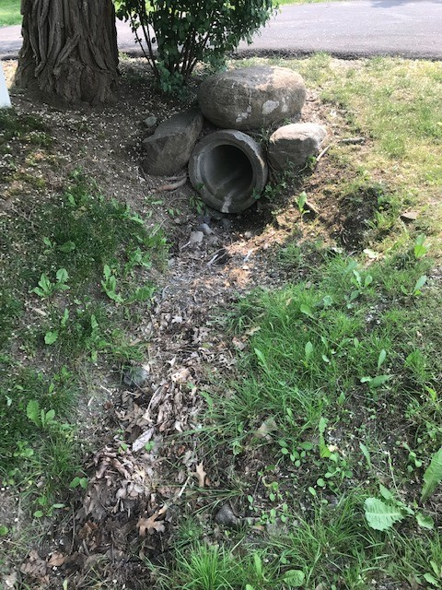
Culvert Data and Quantification
  Condition
    Inlet
    Outlet
    Headwall (as applicable)
    Good/Average/Bad (1-3)
  Impact
    Erosion/Scour
    Embeddedness
    No/Yes (1 or 2)
  Metadata
    Drainage Basin
    Municipality, Jurisdiction
    Road
    Inverts (RTK)
    Material, Shape, Size
    Field Notes (Erosion, Scour, Plugging)
Notes:
At the last presentation we circulated what we called the Action Matrix. Feedback on what actions could be done; gauge opposition and support. Additional input through conversations with districts, and planners.
Currently working refining and filling out the other categories of the matrix and develop on implementation strategy.

Slide 7
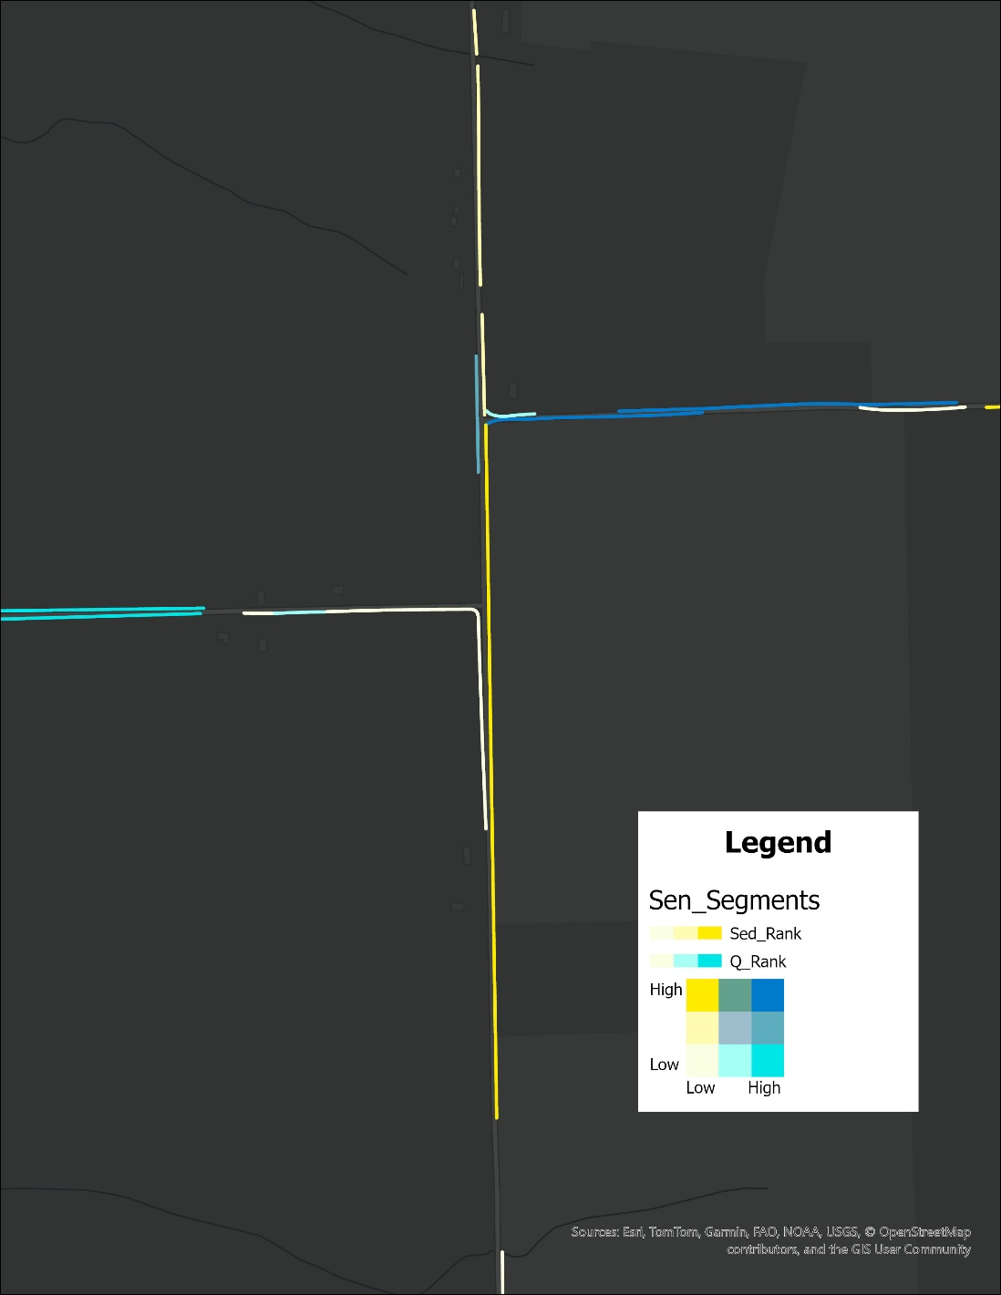
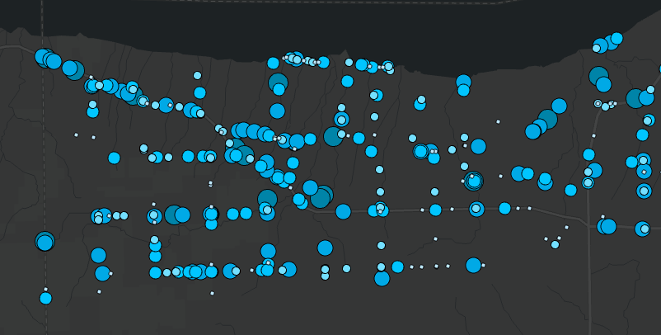
Segment Assessment Results
  Ditches
    922 segments
    Length: 22-6800 ft, 812 avg, 142 mi total
    Slope: 0.03-15.2%, 3.1% avg
    Erosion: 720 stable, 202 eroding (2/3 minor)
    Velocity Control: 758 n/a, 12 fully, 4 partial, 148 unaddressed
  Culverts
    395 culverts
    Condition: 27 n/a, 161 “good”, 1 “worst”
    Impact: 265 embedded, 203 non-erosion/scour
Notes:
At the last presentation we circulated what we called the Action Matrix. Feedback on what actions could be done; gauge opposition and support. Additional input through conversations with districts, and planners.
Currently working refining and filling out the other categories of the matrix and develop on implementation strategy.

Slide 8
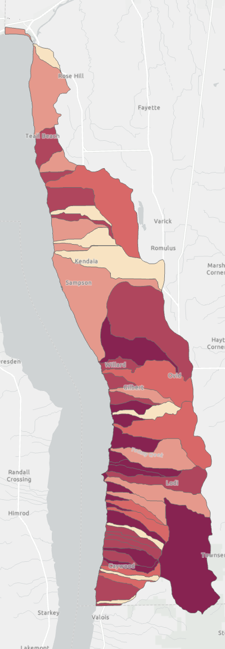
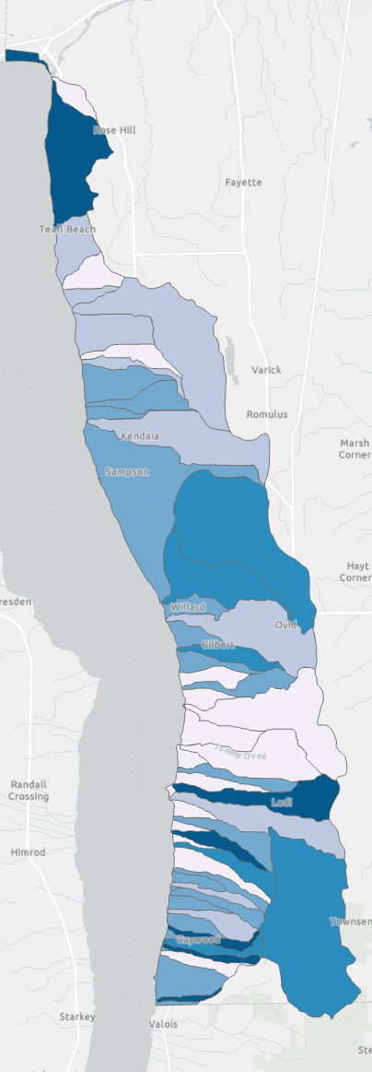
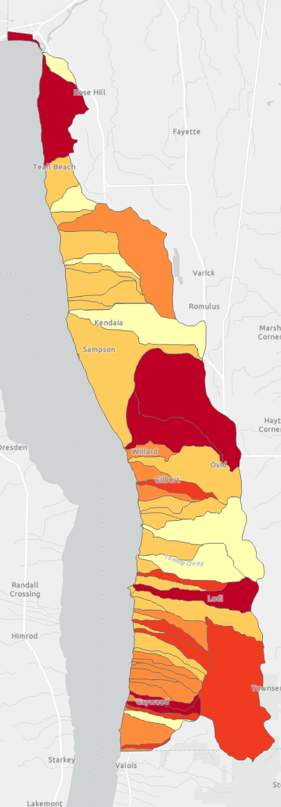
Basin Assessment Results
  Ditches
    6 Basins in “best” condition
    4 “best” from erosion/velocity perspective
    General worsening from N to S
    Sensitive to E-W roads
    High sample size variance
      Range = 2-121, mean = 26, median = 20
  Culverts
    3 Basins in “best” condition*
    Somewhat sensitive to E-W roads
    High sample size variance
      Range = 1-50, mean = 11.3, median = 8
  Joint Assessment
    No clear trend when weighted equally
    No correlation; r = 0.029
    Stronger correlation to velocity but still poor
Notes:
At the last presentation we circulated what we called the Action Matrix. Feedback on what actions could be done; gauge opposition and support. Additional input through conversations with districts, and planners.
Currently working refining and filling out the other categories of the matrix and develop on implementation strategy.

Slide 9
Assessment Conclusions and Questions
  East-West roads tend to be associated with worsening conditions; associated with longer lengths and steeper slopes
  Holistic basin-wide impact of cumulative culvert-ditch network to receiving waters not ultimately determinable without direct quantification. Maybe could get better projection by incorporating density of drainage network but would require redrawing and reanalyzing of basins
  Lack of correlation between culverts-ditches suggests limited impact of one on the other. Private and/or isolated stream culverts may be an explanation
  How to address culverts with unassessed components?
Notes:
At the last presentation we circulated what we called the Action Matrix. Feedback on what actions could be done; gauge opposition and support. Additional input through conversations with districts, and planners.
Currently working refining and filling out the other categories of the matrix and develop on implementation strategy.

Slide 10
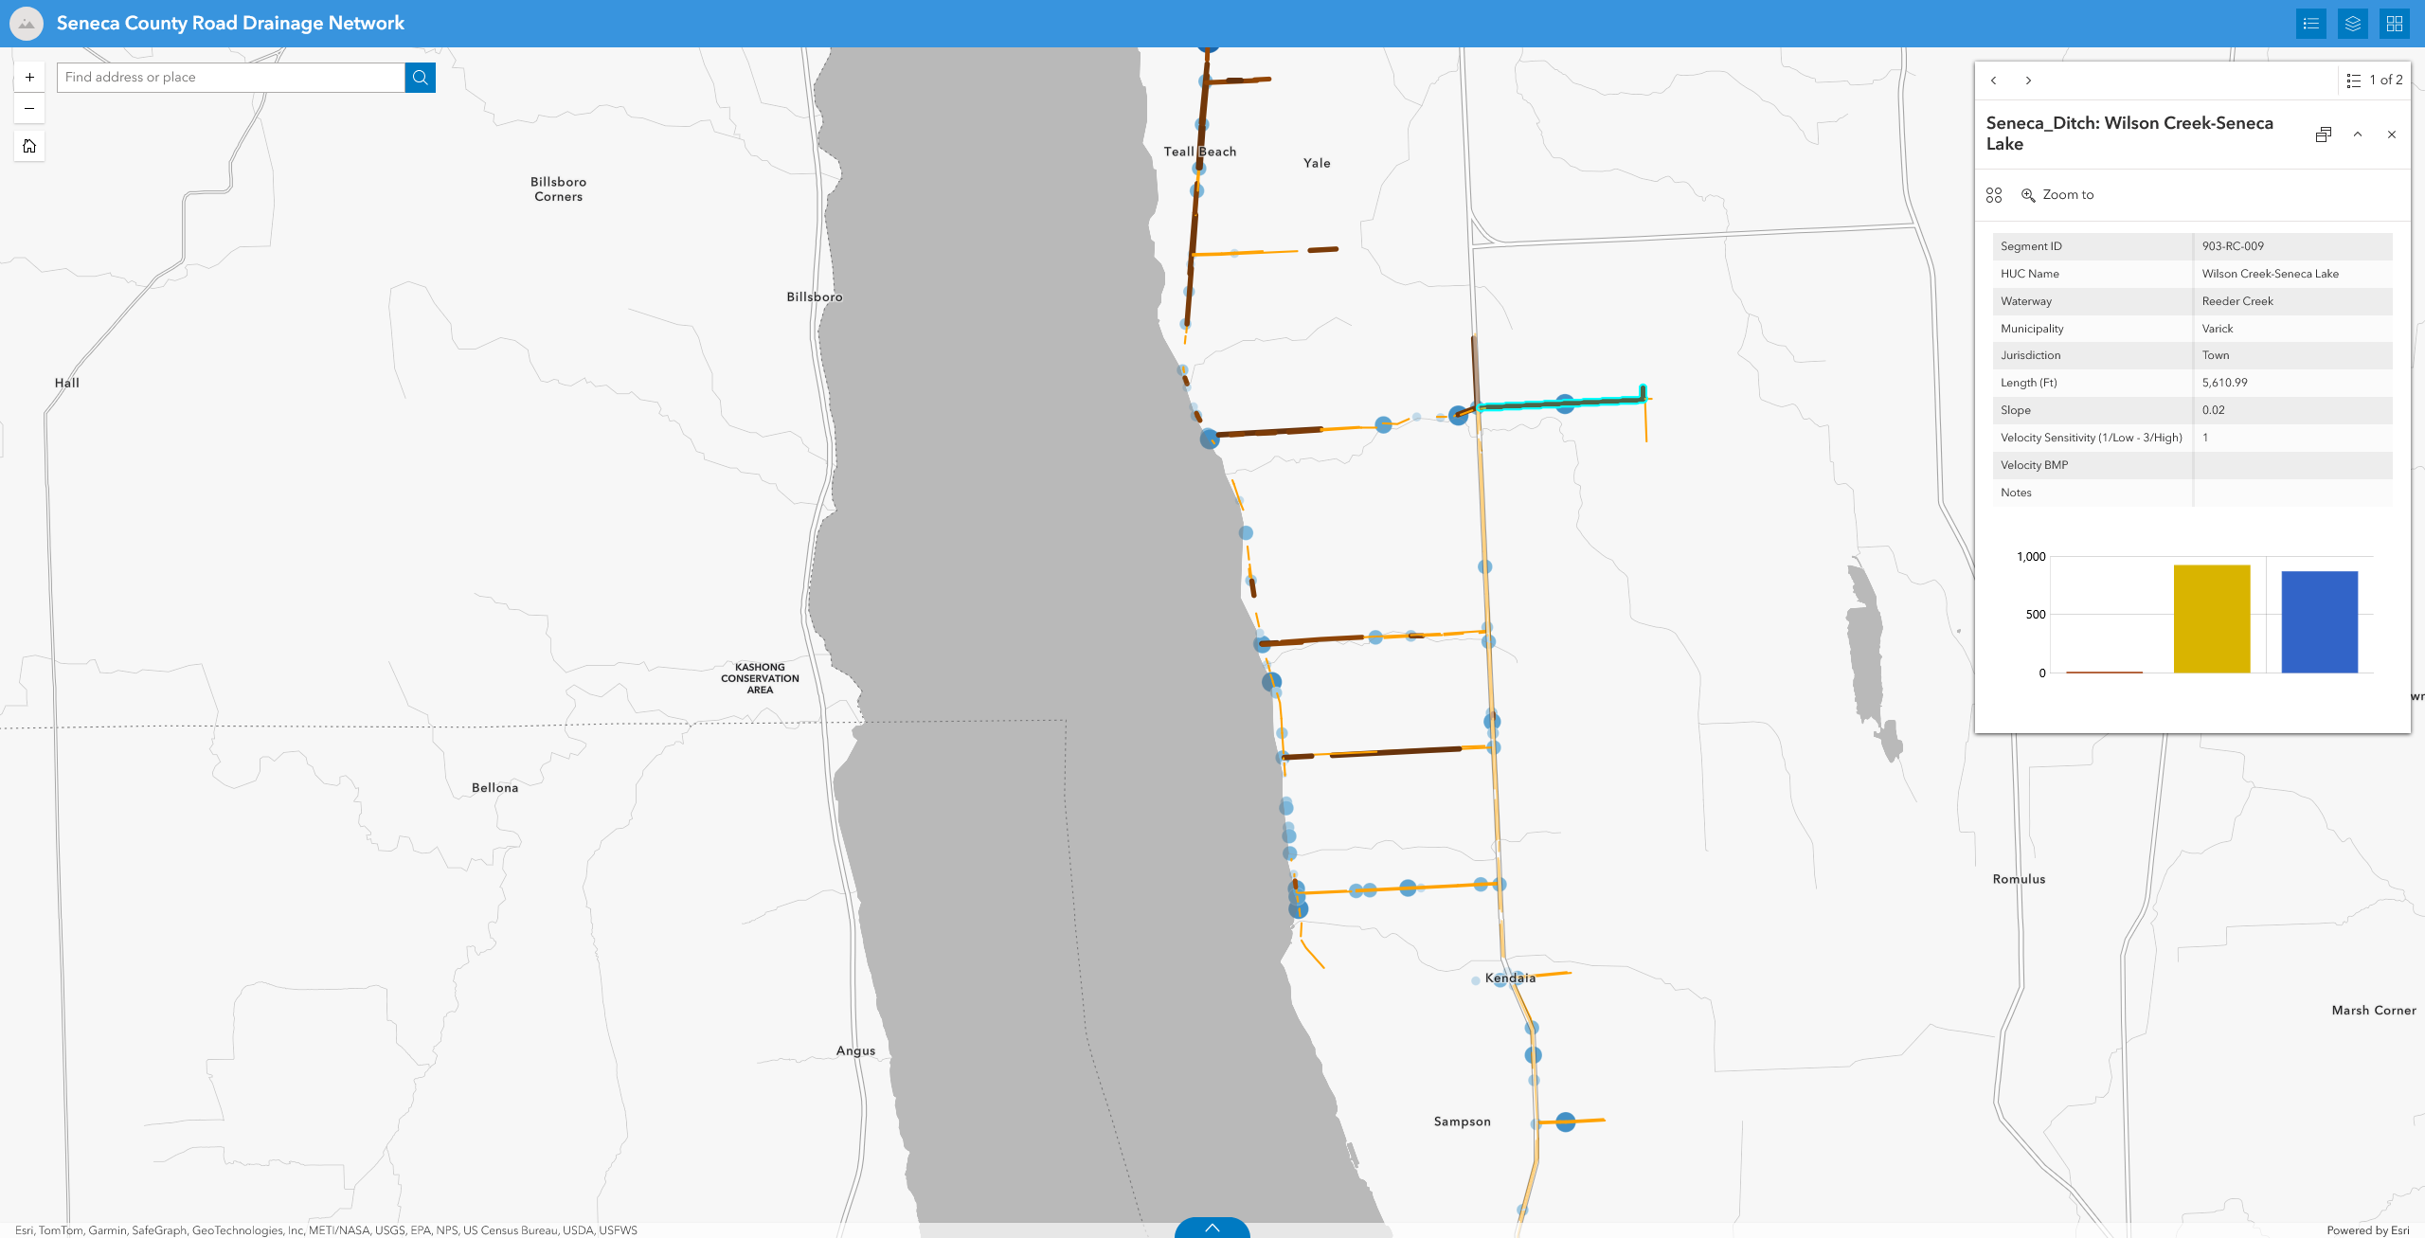
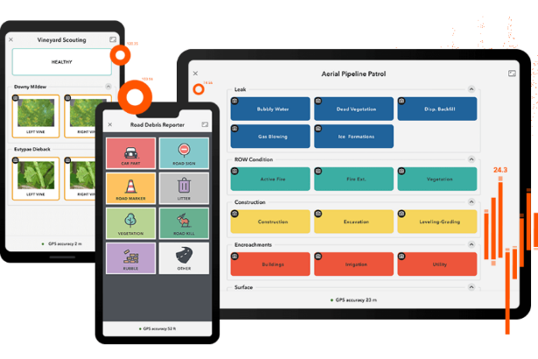
Information Portal and Maintenance
  What info to share?
  General interface/display thoughts?
  How do we keep information up to date? Anyone use ESRI’s new Quick Capture App?
Notes:
At the last presentation we circulated what we called the Action Matrix. Feedback on what actions could be done; gauge opposition and support. Additional input through conversations with districts, and planners.
Currently working refining and filling out the other categories of the matrix and develop on implementation strategy.

